Slide 1
Missing Value Estimation

Slide 2
Methods of Estimating Missing Values
LLSImpute
KNNImpute
NCBI

Slide 3
LLSImpute
Local Least Square Impute
First K values are selected by different correlation coefficients(pearson | Kendall | Spearsman)
Missing values are imputed using linear combination of K selected values
LLS regression are used here to find the optimal values.

Slide 4
Usage
completeObs
boolean -- Return the estimated complete observations if TRUE. This is the input data with NA values replaced by the estimated values
llsImpute(Matrix, k = 10, center = FALSE, completeObs = TRUE, correlation = "pearson", allVariables = FALSE, maxSteps = 100, xval = NULL, verbose = FALSE, ...)
Arguments:
Matrix: Data containing the variables (genes) in columns and observations (samples) in rows.
K: Cluster size, number of similar genes used for regression.
Center: Mean center the data if TRUE
completeObs: Return the estimated complete observations if TRUE.

Slide 5
Correlation: calculate the distance between genes.(pearson | kendall | spearman) allVariables: Use only complete genes to do the regression if TRUE, all genes if FALSE. maxSteps: Maximum number of iteration steps if allGenes = TRUE. Xval: Use LLSimpute for cross validation..

Slide 6
KNNImpute
K-nearest neighbour imputation.
K-values can be taken at random and one giving less error can be selected as optimal k-value.
Identify k samples that are similar or close in the space
The distance used is euclidean distance
K-samples are used to estimate the missing values
Each missing values are imputed using the mean value of k-samples of data.

Slide 7
NCBI
Novel Correlation based imputation technique using Biclustering.

Slide 8
Techniques used in NCBI
Biclustering: An unsupervised learning technique to group subsets of objects considering some features which are highly correlated to each other.
Seed pair : A pair of objects which are highly correlated .

Slide 9
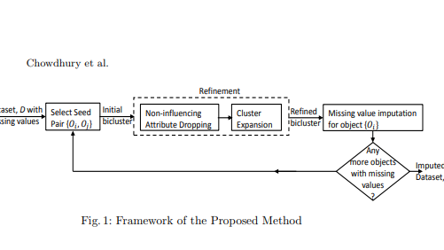
Framework of NCBI

Slide 10
Framework
For each missing value object we create a bicluster to select highly correlated objects. Which is a seed pair.
We drop some attributes which has lowest influence in correlation.
Add other non selected objects which are correlated with the seed pair.
All missing values of object are imputed using a weighted mean function.

Slide 11
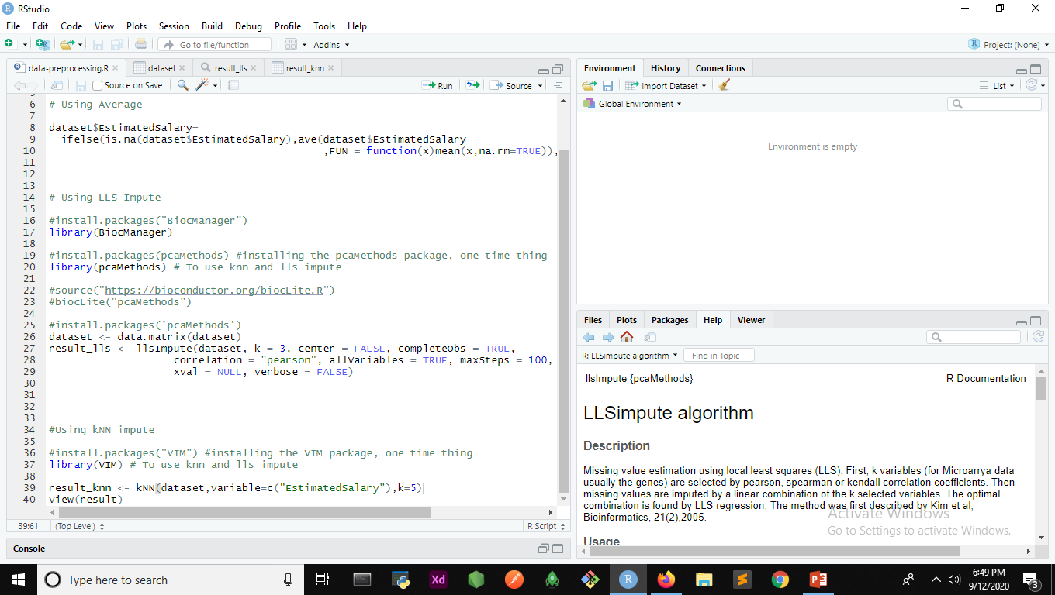
Implementing LLS imputation

Slide 12
Implementing LLS imputation
llsImpute() is a function of package called as pcaMethods, which contains a whole lot of imputation functions apart from llsImpute()
Before using the llsImpute() , we need to make sure that the dataset that we are providing is of type matrix, which now is a simple dataframe. In order to convert it to matrix, use dataset=data.matrix(dataset).
With that we are good to use dataset in our llsImpute(), and now follow the documentation for the usage of several parameters in the function.

Slide 13
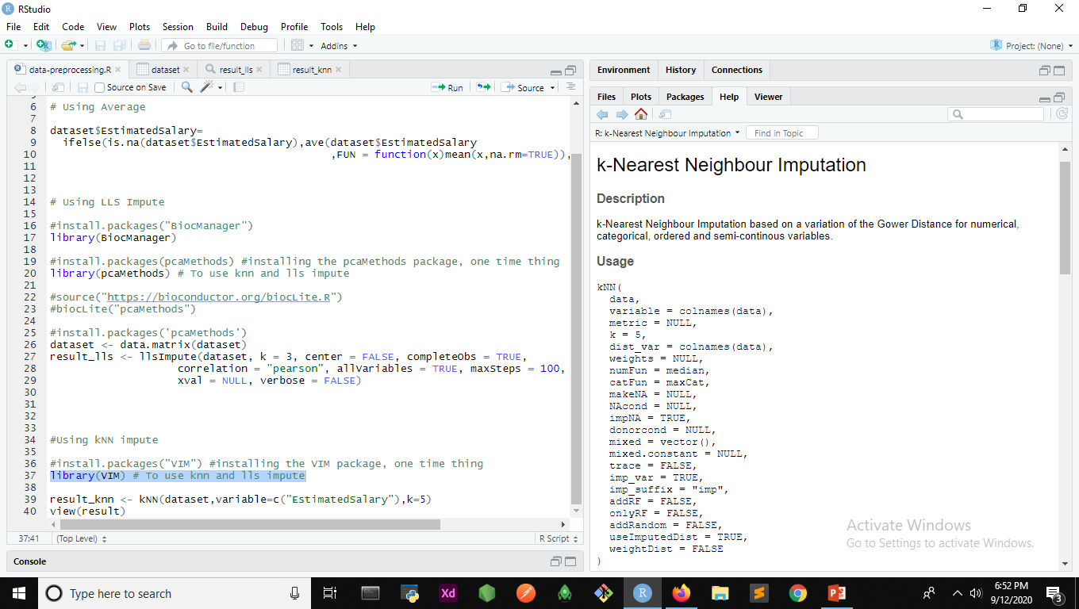
Implementing kNN imputation

Slide 14
Implementing kNN imputation
kNN() is an imputation function that comes with VIM package.
Now note that although we follow the documentation for further instructions and usage of the parameters, there is one important parameter called k, which refers to the no. of nearest neighbours used, which we need to check for the optimal one, which in this case happens to be 5.

